Slide 1
3D Game Basic – Inventory GUIs
Unity3D Basic for Beginners
4th Class
Handityo Aulia Putra
handityo@kmu.ac.kr

Slide 2
Inventory GUIs
Many games involve the player collecting items or choosing from a selection of items.
Examples could be
collecting keys to open doors,
collecting ammo for weapons,
choosing from a collection of spells to cast, and so on.
The recipes in this chapter offer a range of solutions for displaying to the player whether they are carrying an item or not, if they are allowed more than one of an item, and how many they have.

Slide 3
Inventory GUIs – Overview
Creating a simple 2D mini-game – SpaceGirl
Displaying single object pickups with carrying and not-carrying text
Displaying single object pickups with carrying and not-carrying icons

Slide 4
Inventory Design - 1
The two parts of software design for implementing inventories relate to,
first, how we choose to represent the data about inventory items (that is, the data types and structures to store the data)
secondly, how we choose to display information about inventory items to the player (the UI: User Interface).
Also, whilst not strictly inventory items, player properties such as lives left, health, or time remaining can also be designed around the same concepts.

Slide 5
Inventory Design - 2
We need to first think about the nature of different inventory items for any particular game:
Single items
Continuous item
Two or more of the same item
Collections of related items
Collections of different items

Slide 6


Inventory Design – Single item
Example(s): the only key for a level, our suit of magic armor
Data type: bool (true/false)
UI: nothing (if not carried) or text/image to show being carried
Or perhaps text saying "no key"/"key", or two images, one showing an empty key outline and the second showing a full color key.
If we wish to highlight to the player that there is an option to be carrying this item

Slide 7
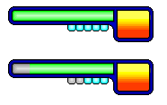
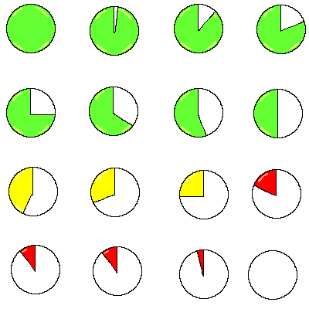
Inventory Design – Continuous item
Example(s):
time left,
health,
shield strength, etc.
Data type:
float (for example, 0.00–1.00) or
integer scale (for example, 0% .. 100%)
UI: text number or image progress bar/pie chart

Slide 8
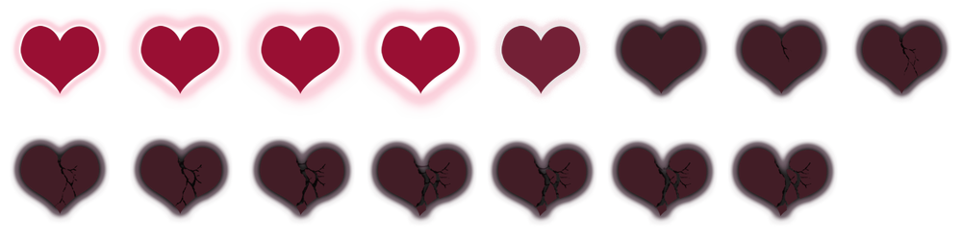
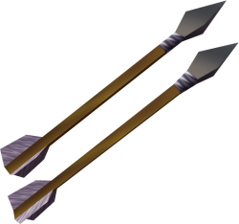
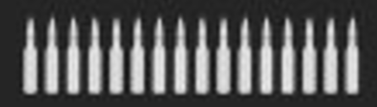
Inventory Design – Two or more of same item
Example(s):
lives left,
number of arrows,
bullets left, etc.
Data type:
int (whole numbers)
UI: text count or images

Slide 9

Inventory Design – Collection of related items
Example(s):
keys of different colors to open correspondingly colored doors,
potions of different strength with different titles, etc.
Data type:
A struct or class for the general item type stored as an array or List<>
Array or List<> of Class Key (color/cost/doorOpenTagString)
UI: text list or list/grid arrangement of icons

Slide 10
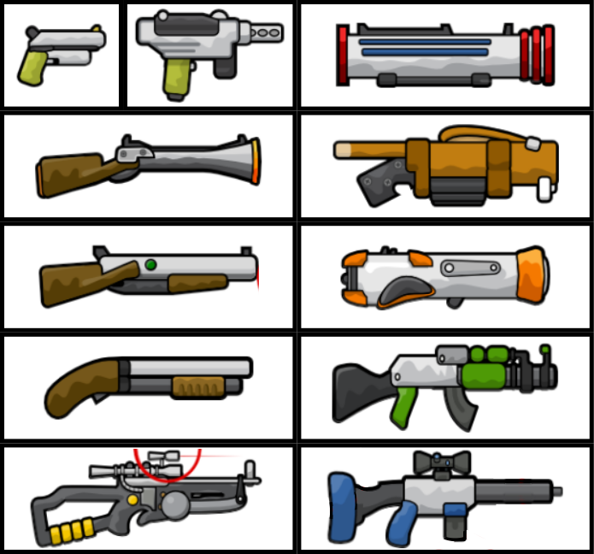
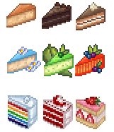
Inventory Design – Collection of different items
Example(s):
keys, potions, weapons, tools—all in the same inventory system
Data type:
List<> or Dictionary<> or array of objects, which can be instances of different class for each item type
UI:
text list or list/grid arrangement of icons

Slide 11
2D Mini-Game - SpaceGirl

Slide 12
Space Girl – Getting Ready
Download the assets from ctl.kmu.ac.kr

Slide 13
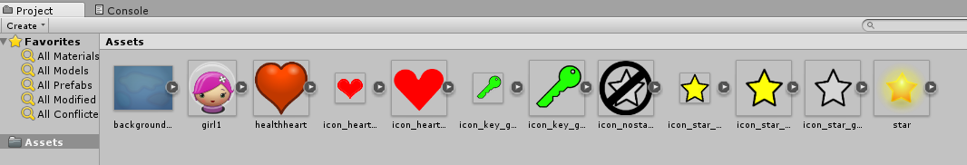
Space Girl – Steps
Create a new, empty 2D project
Import supplied folder Sprites into the project.

Slide 14
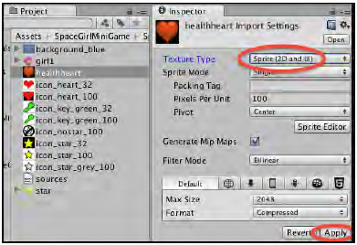
Space Girl – Steps
Convert each sprite image to be of type Sprite (2D and UI).
Select the sprite in the Project panel, then,
in the Inspector, change choose Sprite (2D and UI) from the drop-down menu Texture Type, and click on the Apply button

Slide 15
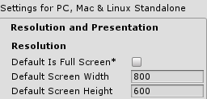
Space Girl – Steps
Set the Unity Player screen size to 800 x 600:
choose the Edit > Project Settings > Player menu,
then for option Resolution and Presentation uncheck Default is Full Screen, and
set the width to 800 and height to 600,

Slide 16
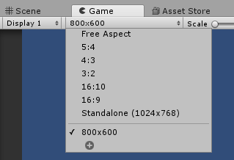
Space Girl – Steps
5. Select the Game panel;
Then choose Standalone (800 x 600) from the drop-down menu

Slide 17
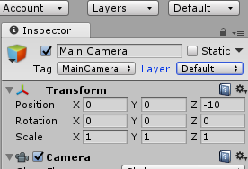
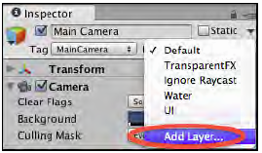
Space Girl – Steps
6. Display the Tags & Layers properties for the current Unity project.
Choose menu Edit | Project Settings | Tags and Layers.
Alternatively, if you are already editing a GameObject, then you can select the Add Layer… menu from the Layer drop-down menu at the top of the Inspector panel, as shown in the following screenshot:

Slide 18
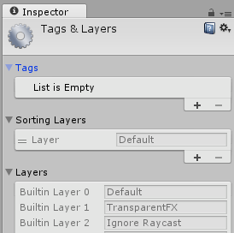
Space Girl – Steps
7. The Inspector should now being displaying the Tags & Layers properties for the current Unity project.
Use the expand/contract triangle tools to contract Tags and Layers, and to expand Sorting Layers.

Slide 19
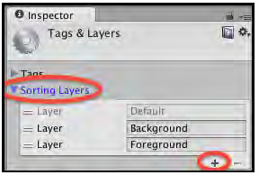
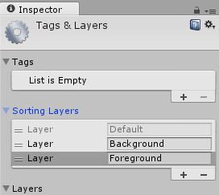
Space Girl – Steps
8. Use the plus sign + button to add two new sorting layers,
first, add one named Background, and
next, add one named Foreground.
The sequence is important,
since Unity will draw items in layers further down this list on top of items earlier in the list.

Slide 20
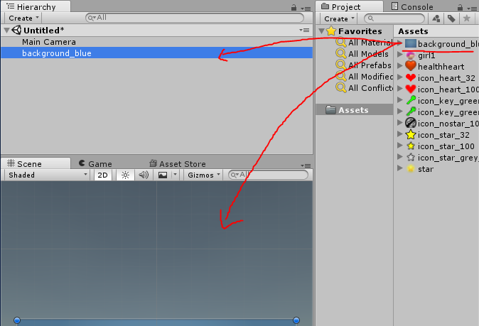
Space Girl – Steps
9. Drag the sprite background-blue from the Project panel (folder Sprites) into either the Game or Hierarchy panel to create a GameObject for the current scene.

Slide 21
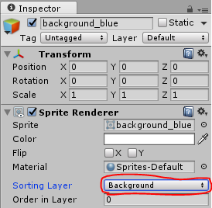
Space Girl – Steps
10. Set the Sorting Layer of GameObject background-blue to Background (in the Sprite Renderer component).

Slide 22
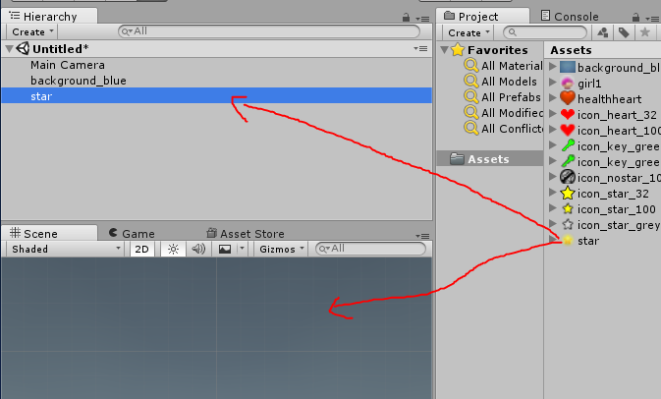
Space Girl – Steps
11. Drag sprite star from the Project panel (folder Sprites) into either the Game or Hierarchy panel to create a GameObject for the current scene.

Slide 23
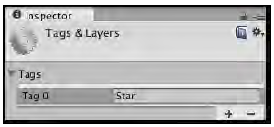
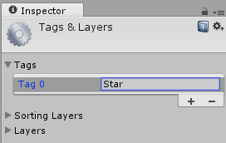
Space Girl – Steps
12. In the Inspector panel,
add a new tag Star by selecting the Add Tag… option from the Tag drop-down menu at the top of the Inspector panel, as shown in the following screenshot:

Slide 24
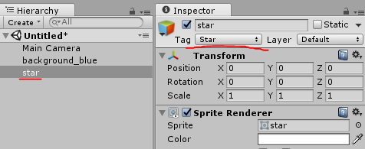
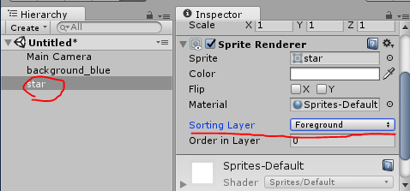
Space Girl – Steps
13. Apply the Star tag to GameObject star in the Hierarchy scene.
14. Set the Sorting Layer of GameObject star to Foreground
(in the Sprite Renderer component).

Slide 25
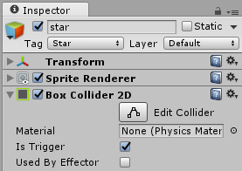
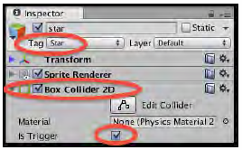
Space Girl – Steps
15. Add to GameObject star a Box Collider 2D
(Add Component | Physics 2D | Box Collider 2D) and
check its Is Trigger, as shown in the following screenshot:

Slide 26
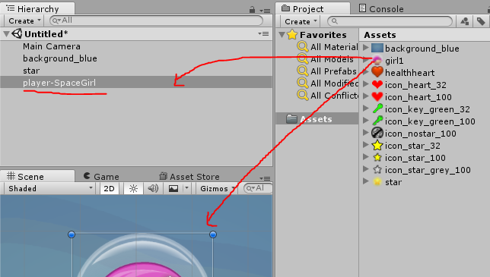
Space Girl – Steps
16. Drag sprite girl1 from the Project panel (folder Sprites) into either the Game or Hierarchy panel to create a GameObject for the player's character in the current scene.
Rename this GameObject player-SpaceGirl.

Slide 27
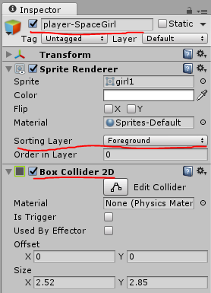
Space Girl – Steps
17. Set the Sorting Layer of GameObject player-SpaceGirl to Foreground
(in the Sprite Renderer component).
18. Add to GameObject player-SpaceGirl a Box Collider 2D (Add Component | Physics 2D | Box Collider 2D).

Slide 28
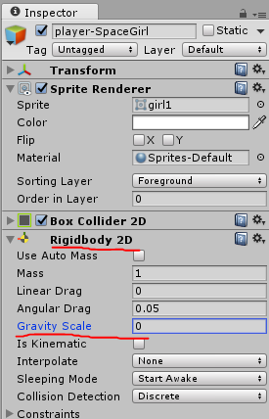
Space Girl – Steps
19. Add to GameObject player-SpaceGirl a RigidBody 2D
(Add Component | Physics 2D | Rigid Body 2D).
Set its Gravity Scale to zero
(so it isn't falling down the screen due to simulated gravity)

Slide 29
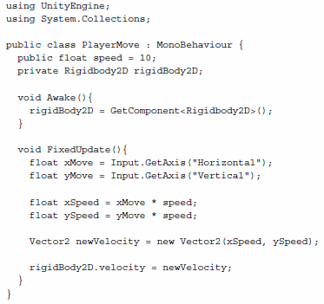
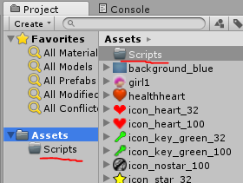
Space Girl – Steps
20. Create a new folder for your scripts named Scripts.
21. Create the following C# Script PlayerMove
(in folder Scripts)

Slide 30
Space Girl – Steps
22. add an instance as a component to GameObject player-SpaceGirl in the Hierarchy
(Attach the script to the player-SpaceGirl GameObject, in Inspector Panel)
23. Save the scene (name it Main Scene and save it into a new folder named Scenes).
using UnityEngine; using System.Collections;
public class PlayerMove : MonoBehaviour{
public float speed = 10; private Rigidbody2D rigidBody2D;
void Awake(){ rigidBody2D = GetComponent<Rigidbody2D>(); } void FixedUpdate(){ float xMove = Input.GetAxis("Horizontal"); float yMove = Input.GetAxis("Vertical"); float xSpeed = xMove * speed; float ySpeed = yMove * speed; Vector2 newVelocity = new Vector2(xSpeed, ySpeed);
rigidBody2D.velocity = newVelocity; } }

Slide 31
Space Girl – Details…
We have created a player character in the scene, with its movement scripted component PlayerMove.
We have also created a star GameObject (a pickup), tagged Star and with a 2D box collider that will trigger a collision when the player's character hits it.
When we run the game, the player-SpaceGirl character should move around using the W A S D, arrow keys, or joystick.
Currently, nothing will happen if the player-SpaceGirl character hits a star since that has yet to be scripted.
We have added a background (GameObject background-blue) to the scene, which will be behind everything since it is in the rearmost sorting layer Background.
Items we want to appear in front of this background (the player's character and the star so far) are placed on sorting layer Foreground.
Learn more about Unity tags and layers at http://docs.unity3d.com/Manual/class-TagManager.html

Slide 32
Displaying single object pickups

Slide 33
Displaying single object pickups – Getting Ready
For this Project we can do the following:
Continue from previous project
If you do not have the previous project
Create a new, empty 2D project
Import the Simple2Dgame_SpaceGirl package
Open scene Scene1 (in the Scenes folder)
Set the Unity Player screen size to 800 x 600
(see the previous recipe for how to do this)
select this resolution in the Game panel the drop-down menu.
Convert each sprite image to be of type Sprite (2D and UI).
In the Inspector, choose Sprite (2D and UI) from drop-down menu Texture Type, and click on the Apply button.

Slide 34
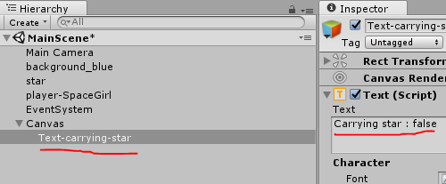
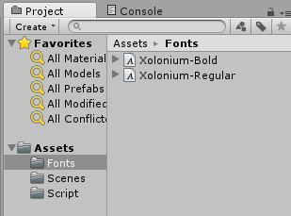
Displaying single object pickups - Steps
1. Start with a new copy of mini-game Simple2Dgame_SpaceGirl.
2. Add a UI Text object (Create | UI | Text).
Rename it Text-carrying-star.
Change its text to “Carrying star: false”.
3. Import the provided Fonts folder into your project.

Slide 35
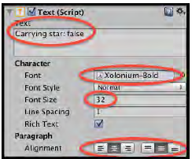
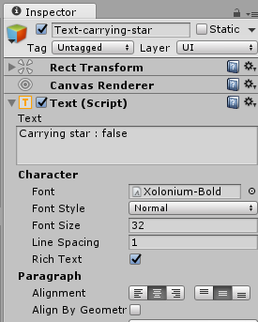
Displaying single object pickups - Steps
4. In the Inspector panel,
set the font of Text-carrying-star to Xolonium-Bold (folder Fonts), and
set its color to yellow.
Center the text horizontally and vertically, and
set its Height to 50, and
set the Font Size to 32,

Slide 36
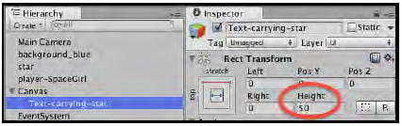
Displaying single object pickups - Steps
5. In the Rect Transform component of Text-carrying-star GameObject,
set its Height to 50, as shown in the next screenshot:

Slide 37
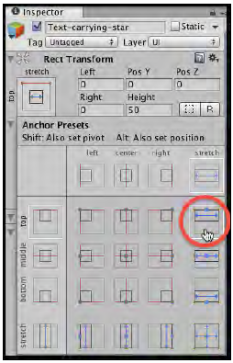
Displaying single object pickups - Steps
6. Edit its Rect Transform
while holding down SHIFT and ALT
(to set pivot and position),
choose the top-stretch box,
as shown in the following screenshot:

Slide 38

Displaying single object pickups - Steps
7. Your text should now be positioned at the middle top of the Game panel, and its width should stretch to match that of the whole panel, as shown in the next screenshot:

Slide 39
Displaying single object pickups - Steps
8. Add the following C# Script Player to GameObject player-SpaceGirl in the Hierarchy:
using UnityEngine; using System.Collections; using UnityEngine.UI; public class Player : MonoBehaviour { public Text starText; private bool carryingStar = false; void Start(){ UpdateStarText(); } void OnTriggerEnter2D(Collider2D hit){ if(hit.CompareTag("Star")){ carryingStar = true; UpdateStarText(); Destroy(hit.gameObject); } } private void UpdateStarText(){ string starMessage = "no star :-("; if(carryingStar) starMessage = "Carrying star :-)"; starText.text = starMessage; } }

Slide 40
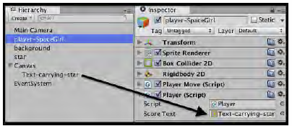
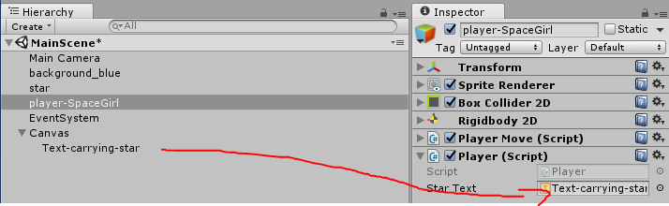
Displaying single object pickups - Steps
9. From the Hierarchy view,
select the GameObject player-SpaceGirl.
Then, from the Inspector,
access the Player (Script) component and
populate the Star Text public field with UI Text object Text-carrying-star

Slide 41
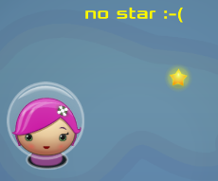
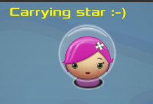
Displaying single object pickups - Steps
10. When you play the scene,
after moving the character into the star,
the star should disappear, and
the onscreen UI Text message should change to Carrying star :-)

Slide 42
Displaying single object pickups – How it works
The Text variable starText is a reference to the UI Text object Text-carrying-star.
The bool variable carryingStar represents whether or not the player is carrying the star at any point in time; it is initialized to false.
The UpdateStarText() method copies the contents of the starMessage string to the text property of starText.
The default value of this string tells the user that the player is not carrying the star, but an if statement tests the value of carryingKey, and, if that is true, then the message is changed to inform the player that they are carrying the star.

Slide 43
Displaying single object pickups – How it works
Each time the player's character collides with any object that has its Is Trigger set to true, an OnTriggerEnter2D() event message is sent to both objects involved in the collision.
The OnTriggerEnter2D() message is passed a parameter that is the Collider2D component inside the object just collided with.

Slide 44
Displaying single object pickups – How it works
Our player's OnTriggerEnter2D() method tests the tag string of the object collided with to see if it has the value Star.
Since the GameObject star we created has its trigger set, and has the tag Star,
the if statement inside this method will detect a collision with star and complete three actions:
it sets the Boolean variable carryingStar to true,
it calls the method UpdateStarText(), and
it destroys the GameObject it has just collided with (in this case, star).

Slide 45
Displaying single object pickups – How it works
When the scene begins, via the Start() method, we call the UpdateStarText() method;
this ensures that we are not relying on text typed into the UI Text object Text-carryingstar at design time, but that the UI seen by the user is always set by our run-time methods.
This avoids problems where
the words to be displayed to the user are changed in code and not in the Inspector panel
which leads to a mismatch between the onscreen text when the scene first runs and after it has been updated from a script.

Slide 46
Displaying single object pickups – Addition
The separation of view logic
A game design pattern (best practice approach) called the Model-View-Controller pattern (MVC) is
to separate the code that updates the UI from the code that changes player and game variables such as score and inventory item lists.
Although this project has only one variable and one method to update the UI,
well-structured game architectures scale up to cope with more complex games,
so it is often worth the effort of a little more code and an extra script class, even at this game-beginning stage, if we want our final game architecture to be well structured and maintainable.

Slide 47
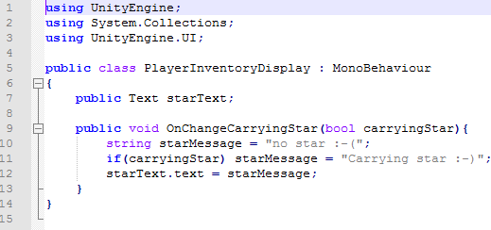
Displaying single object pickups – Addition
To implement the separation of view pattern for this recipe, we need to do the following:
1. Add the following C# Script PlayerInventoryDisplay to GameObject

Slide 48
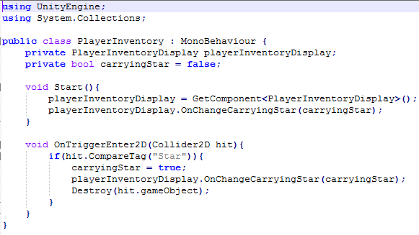
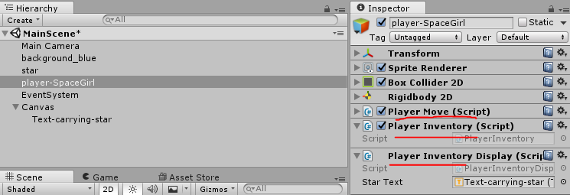
Displaying single object pickups – Addition
2. From the Hierarchy view,
select the GameObject player-SpaceGirl.
Then, from the Inspector,
access the PlayerInventoryDisplay (Script) component and populate the Score Text public field with the UI Text object Text-carrying-star.
3. Remove the existing C# Script component Player and replace it with this C# Script PlayerInventory containing the following code:

Slide 49
Displaying single object pickups – Addition
the PlayerInventory script class no longer has to maintain a link to the UI Text or worry about changing the text property of that UI component
all that work is now the responsibility of the PlayerInventoryDisplay script.
When the Player instance component detects a collision with the star,
after changing the carryingStar bool flag's value to true,
it just calls the OnChangeCarryingStar() method of the PlayerInventoryDisplay component.

Slide 50
Displaying single object pickups – Addition
The result is that the code for the script class PlayerInventory concentrates on the player collision and status variables, while the code for the script class PlayerInventoryDisplay handles the communication to the user.
Another advantage of this design pattern is that
the method in which the information is communicated to the user via the UI can be changed (for example, from text to an icon),
without any change to the code in script class Player.
There is no difference in the experience of the player, and all the changes are to improve the architectural structure of our game code.

Slide 51
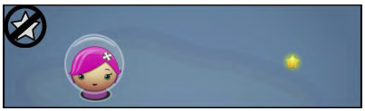
Displaying single object pickups with icons

Slide 52
Displaying single object pickups with icons
Graphic icons are an effective way to inform the player that they are carrying an item.
If no star is being carried, a grey-filled icon in a blocked-off circle is displayed;
then, after the star has been picked up, a yellow-filled icon is displayed,

Slide 53
Displaying single object pickups with icons
1. Continue from previous project or start with a new copy of the mini-game Simple2Dgame_SpaceGirl.
2. In the Hierarchy panel,
add a new UI Image object (Create | UI | Image).
Rename it Image-star-icon.
3. Select Image-star-icon in the Hierarchy panel.
4. From the Project panel,
drag the sprite icon_nostar_100 (folder Sprites) into the Source Image field in the Inspector (in the Image (Script) component).

Slide 54
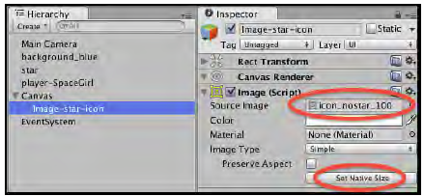
5. Click on the Set Native Size button for the Image component.
This will resize the UI Image to fit the physical pixel width and height of sprite file icon_nostar_100

Slide 55
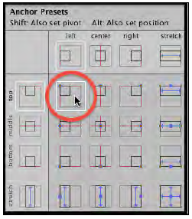
6. (Optional)
Position icon at the top and left of the Game panel.
Edit the UI Image's Rect Transform component, and while holding down SHIFT and ALT (to set pivot and position), choose the top-left box.
The UI Image should now be positioned at the top left of the Game panel

Slide 56
using UnityEngine; using System.Collections; using UnityEngine.UI; public class Player : MonoBehaviour { public Image starImage; public Sprite iconStar; public Sprite iconNoStar; private bool carryingStar = false; void OnTriggerEnter2D(Collider2D hit) { if(hit.CompareTag("Star")){ carryingStar = true; UpdateStarImage(); Destroy(hit.gameObject); } } private void UpdateStarImage() { if(carryingStar) starImage.sprite = iconStar; else starImage.sprite = iconNoStar; } }
7. Add or edit the following C# Script Player to GameObject player-SpaceGirl in the Hierarchy:

Slide 57
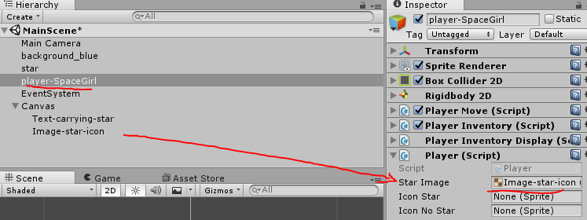
8. From the Hierarchy view,
select the GameObject player-SpaceGirl.
Then, from the Inspector,
access the Player (Script) component and populate the Star Image public field with UI Image object Image-star-icon.

Slide 58
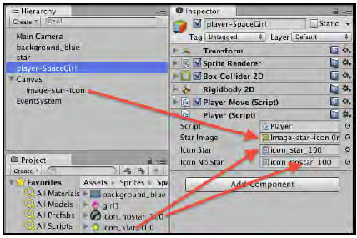
9. Now,
populate the Icon Star public field from the Project panel with sprite icon_star_100 and
populate the Icon No Star public field from the Project panel with sprite icon_nostar_100

Slide 59
10. Now when you play the scene,
you should see the no star icon (a grey-filled icon in a blocked-off circle) at the top left until you pick up the star,
at which point it will change to show the carrying star icon (yellow-filled star).

Slide 60
Try it yourself

Slide 61
Try it differently
If you have finished the 3 mini-projects, there are some things that you can try:
Change the player sprite to other character that you like
Change the star sprite to other icon, such as: keys, swords
Change the control scheme (buttons)
In addition to changing icon/text when collecting the item, you can do few different effect, such as:
Increase the character movement speed
Increase the character size

